Slide 1
Direction-optimizing Breadth-First Search
Paper Review // 6.5060 Algorithm Engineering

Slide 3
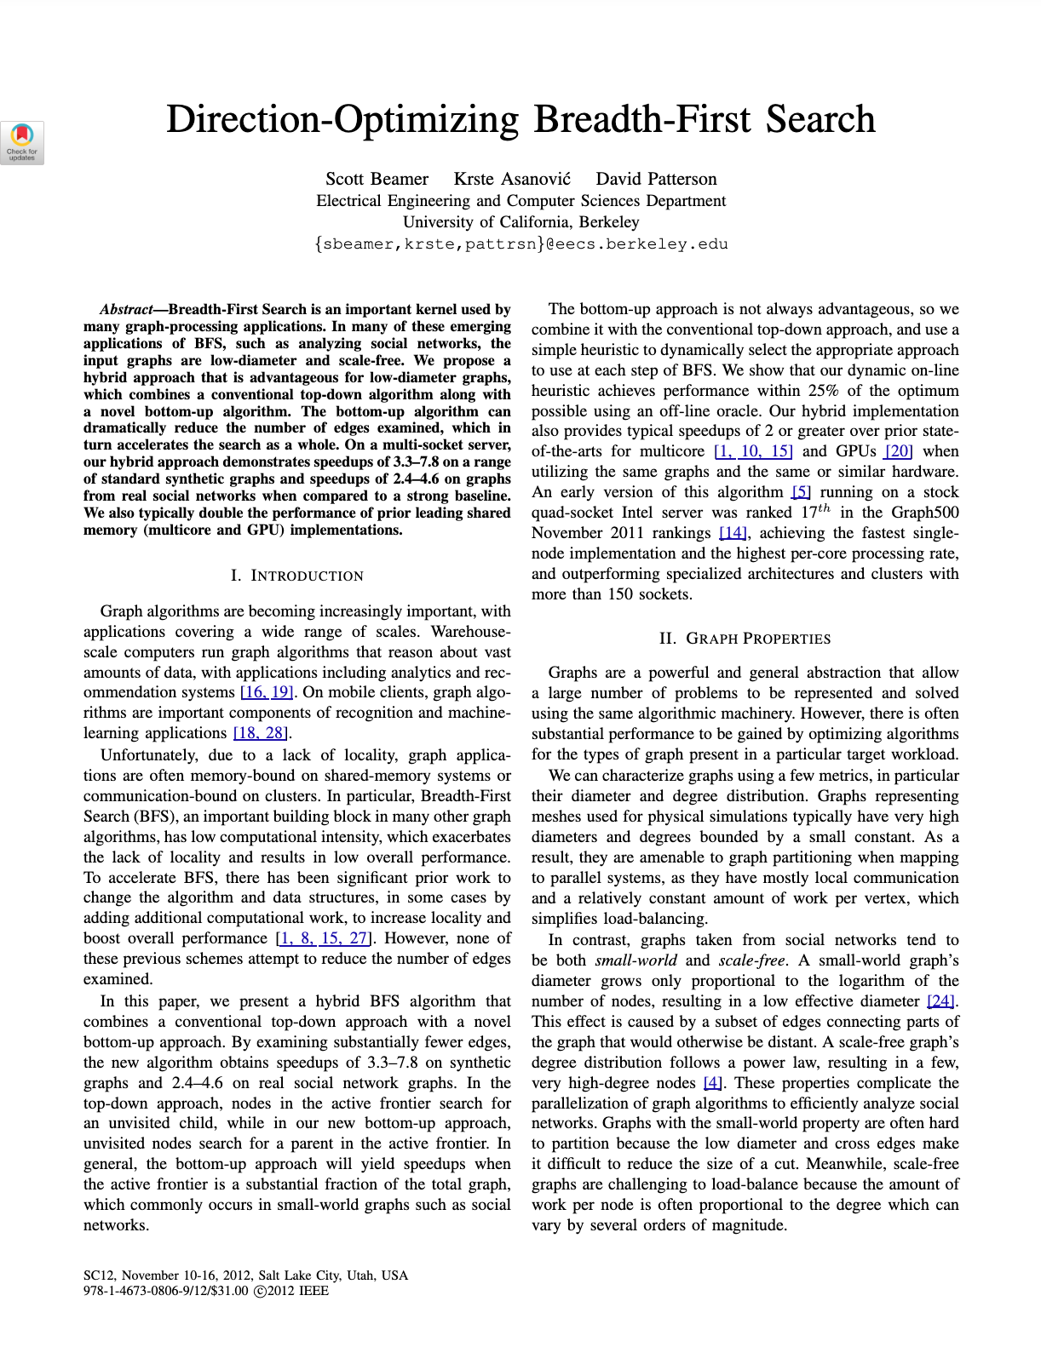

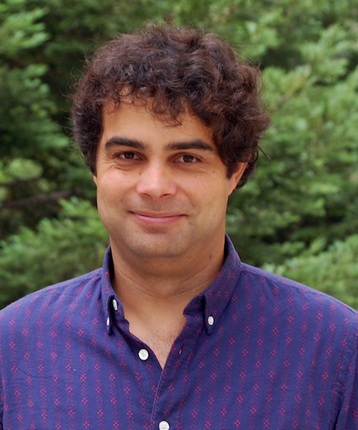
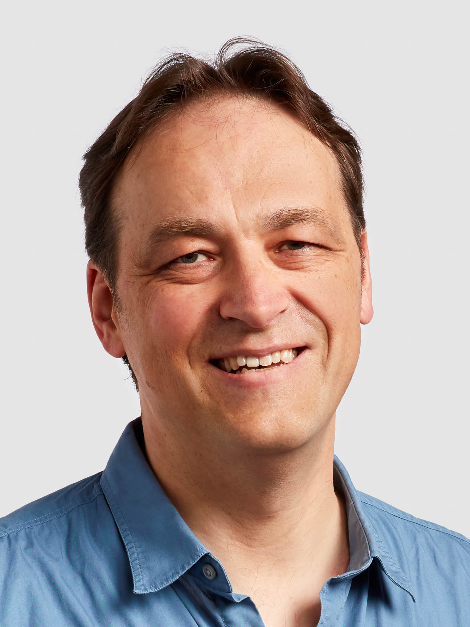

Direction-Optimizing Breadth-First Search (IEEE, 2012)
Authors (Berkeley)
Scott Beamer
Krste Asanović
David Patterson
Notes:
David Patterson of RISC-architecture fame and also apparently the APA RAQ California State Record

Slide 4
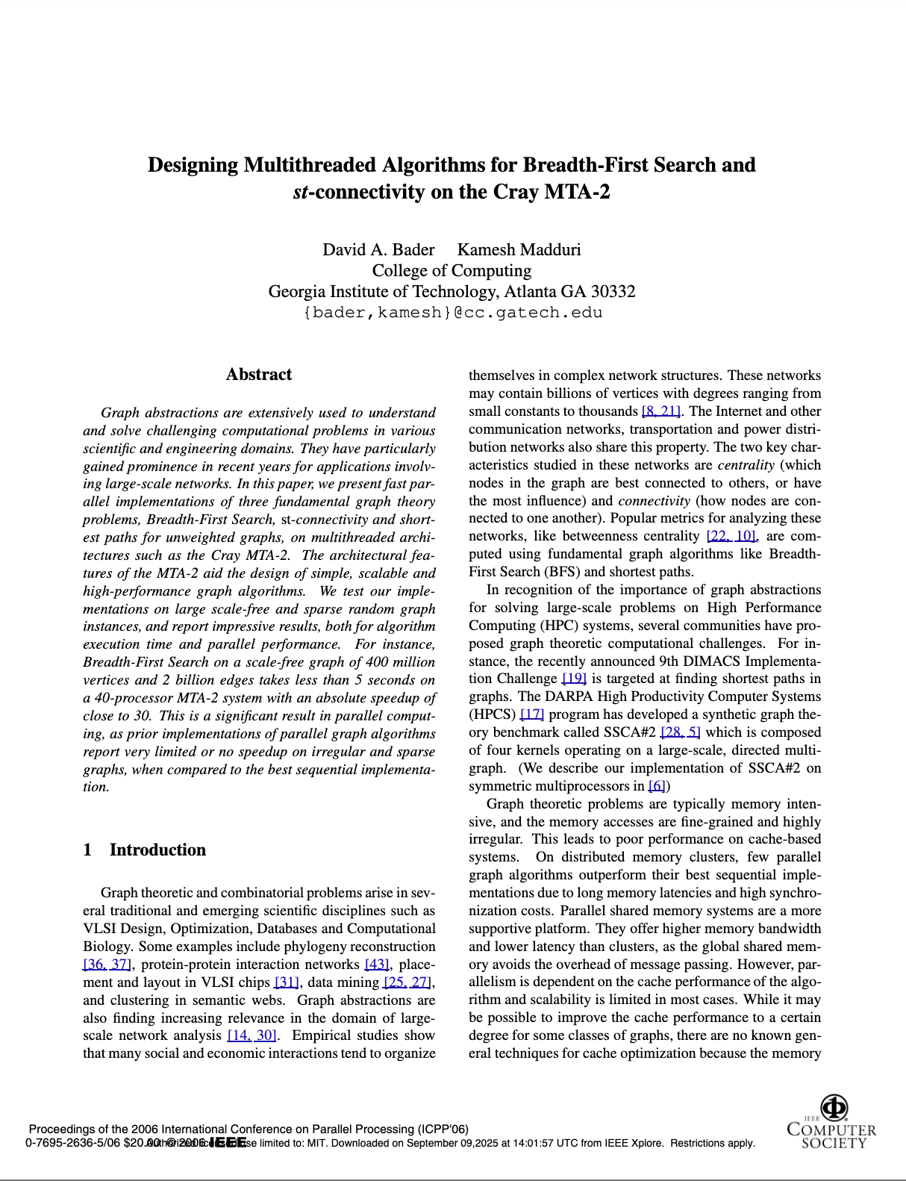
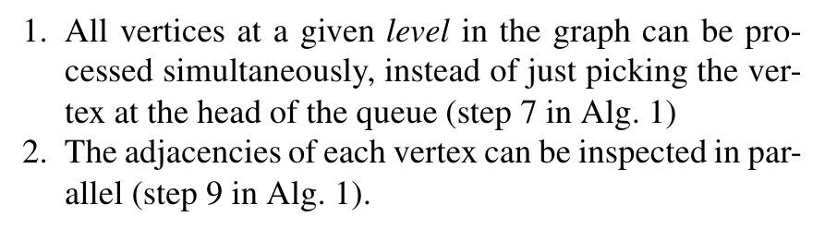
Some background on parallel algorithms for BFS
Designing Multithreaded Algorithms for
Breadth-First Search and st-connectivity
on the Cray MTA-2
Bader and Madduri

Slide 5
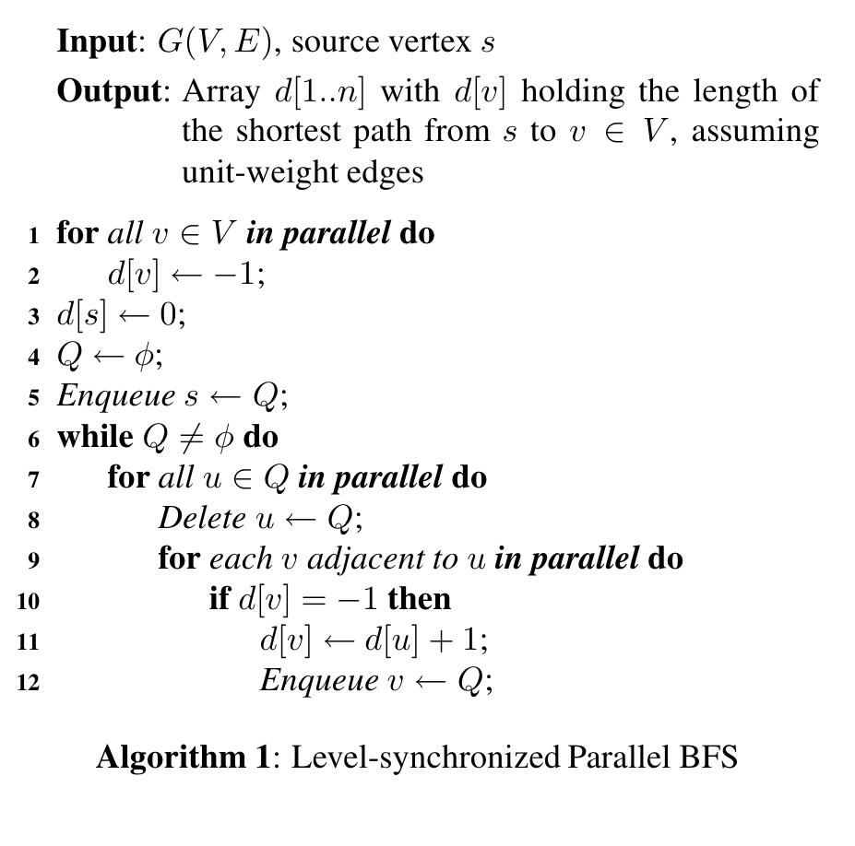
Some background on parallel algorithms for BFS
Designing Multithreaded Algorithms for
Breadth-First Search and st-connectivity
on the Cray MTA-2
Bader and Madduri
Designing parallel BFS to scale on massively parallel architectures (Cray MTA-2)
Every vertex and its neighbours at subsequent levels of the graph is visited simultaneously (no level-level dependency)
Main contribution is mapping onto hardware-specific primitives (#pragma) (not shown here but in paper)
Initialize [-1,...,-1] parent array
Put source into queue Q
While Q not empty
For each vertex in queue
(parallel)
For each neighbor leading
out of queue (parallel), if valid
child, add to queue

Slide 6
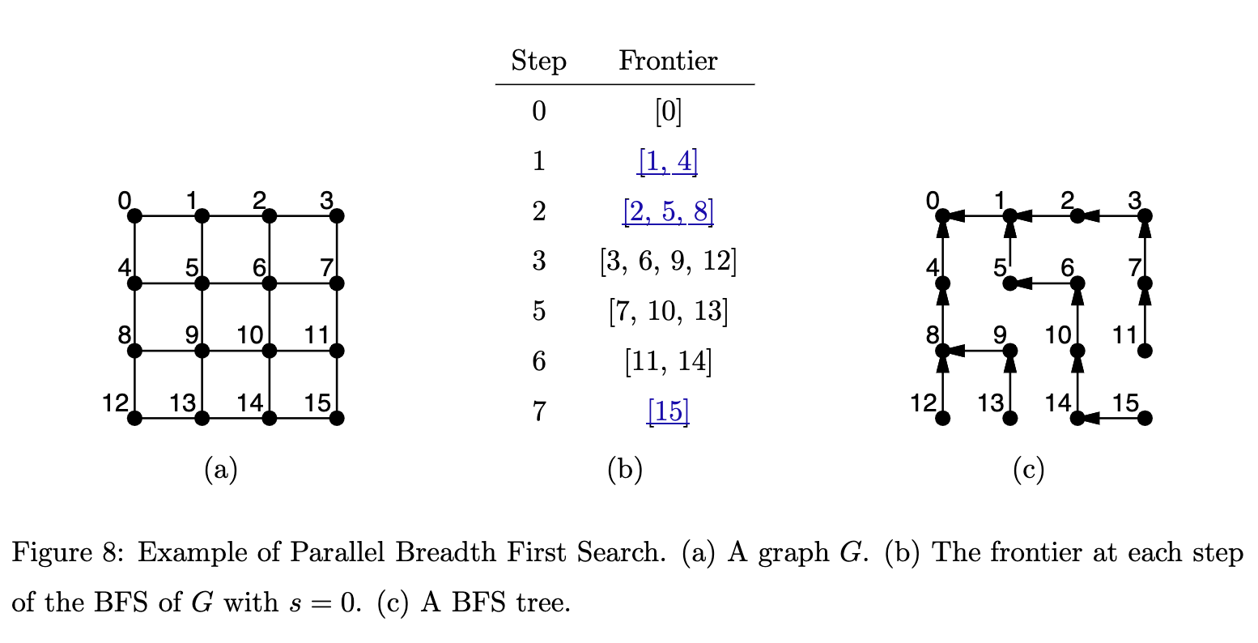
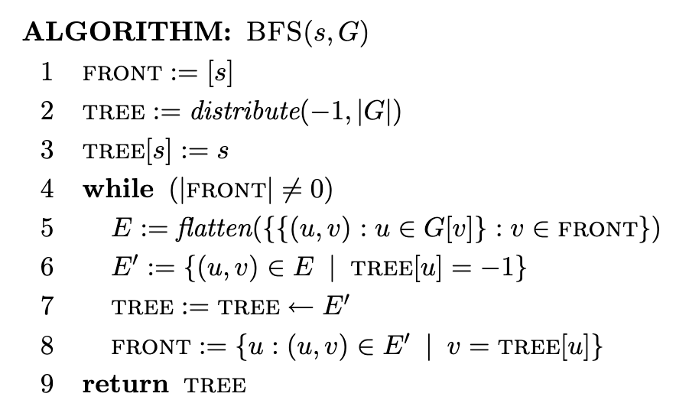
Challenges in designing parallel algorithms for BFS
Maintain a set of frontier values
Parallelism: collect all next frontier values in parallel (must remove duplicates)
Challenges
Inefficiencies: in worst case, every m edge is always visited; every n node is visited (O(n+m))
Standard (TD) BFS almost always takes worst case time
Parallel Algorithms
Blelloch & Maggs

Slide 7
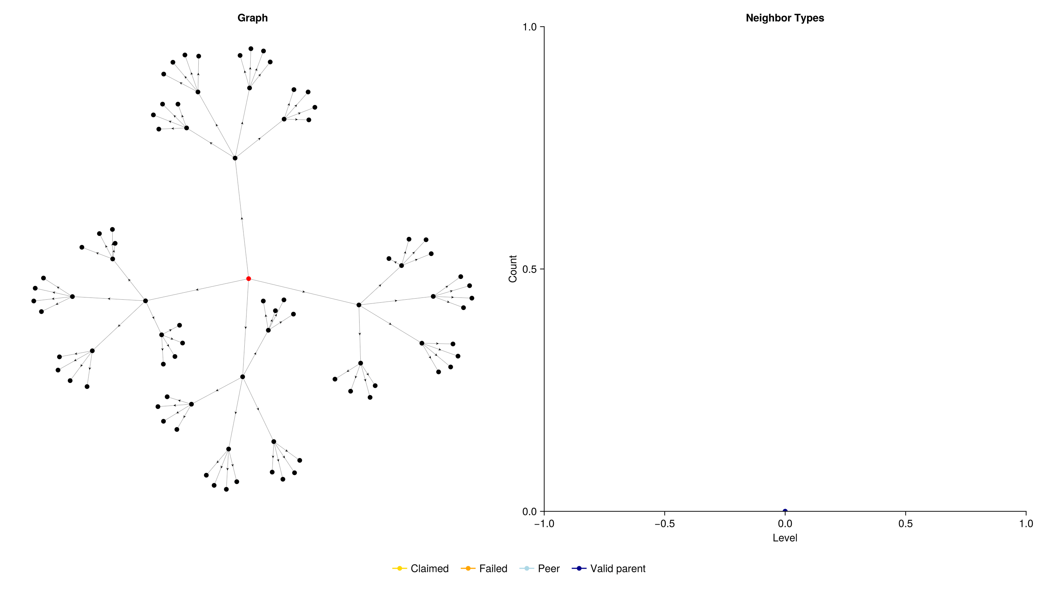
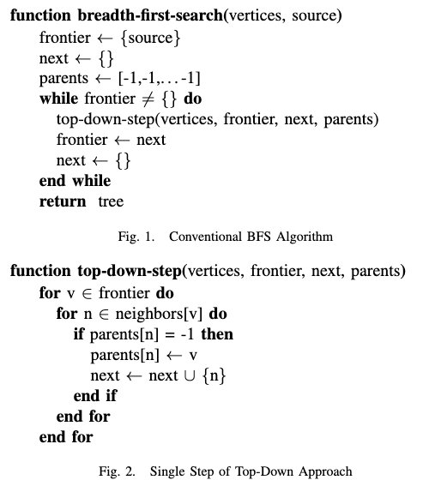
Top-down BFS K-ary Tree Graph (low-degree, high-depth)
Own animation, K-ary tree graph
Beamer et al.
Notes:
Pretty efficient on a k-ary tree like this, every edge explored from the parent node ends up leading to a valid child

Slide 8
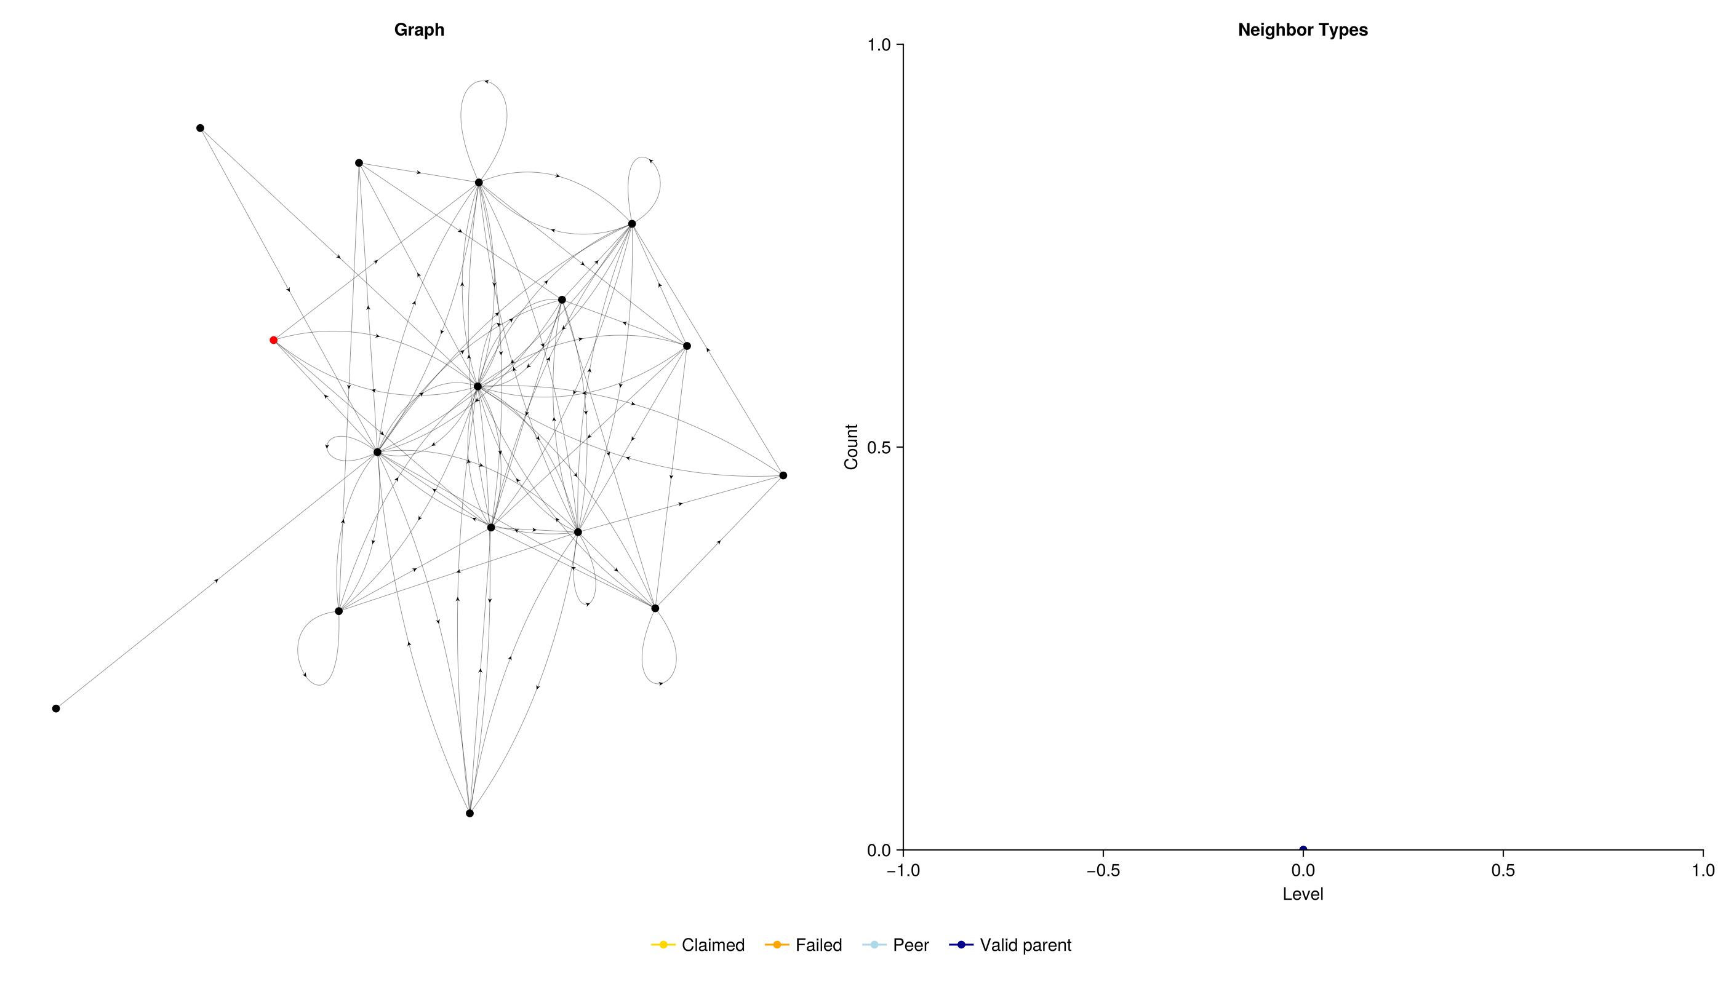
Top-down BFS Kronecker Graph (high-degree, low-depth)
Own animation, Kronecker graph
Beamer et al.
Notes:
Much less efficient on a Kronecker graph where every single connection gets explored even when the connections are not going to lead to a useful child.

Slide 9
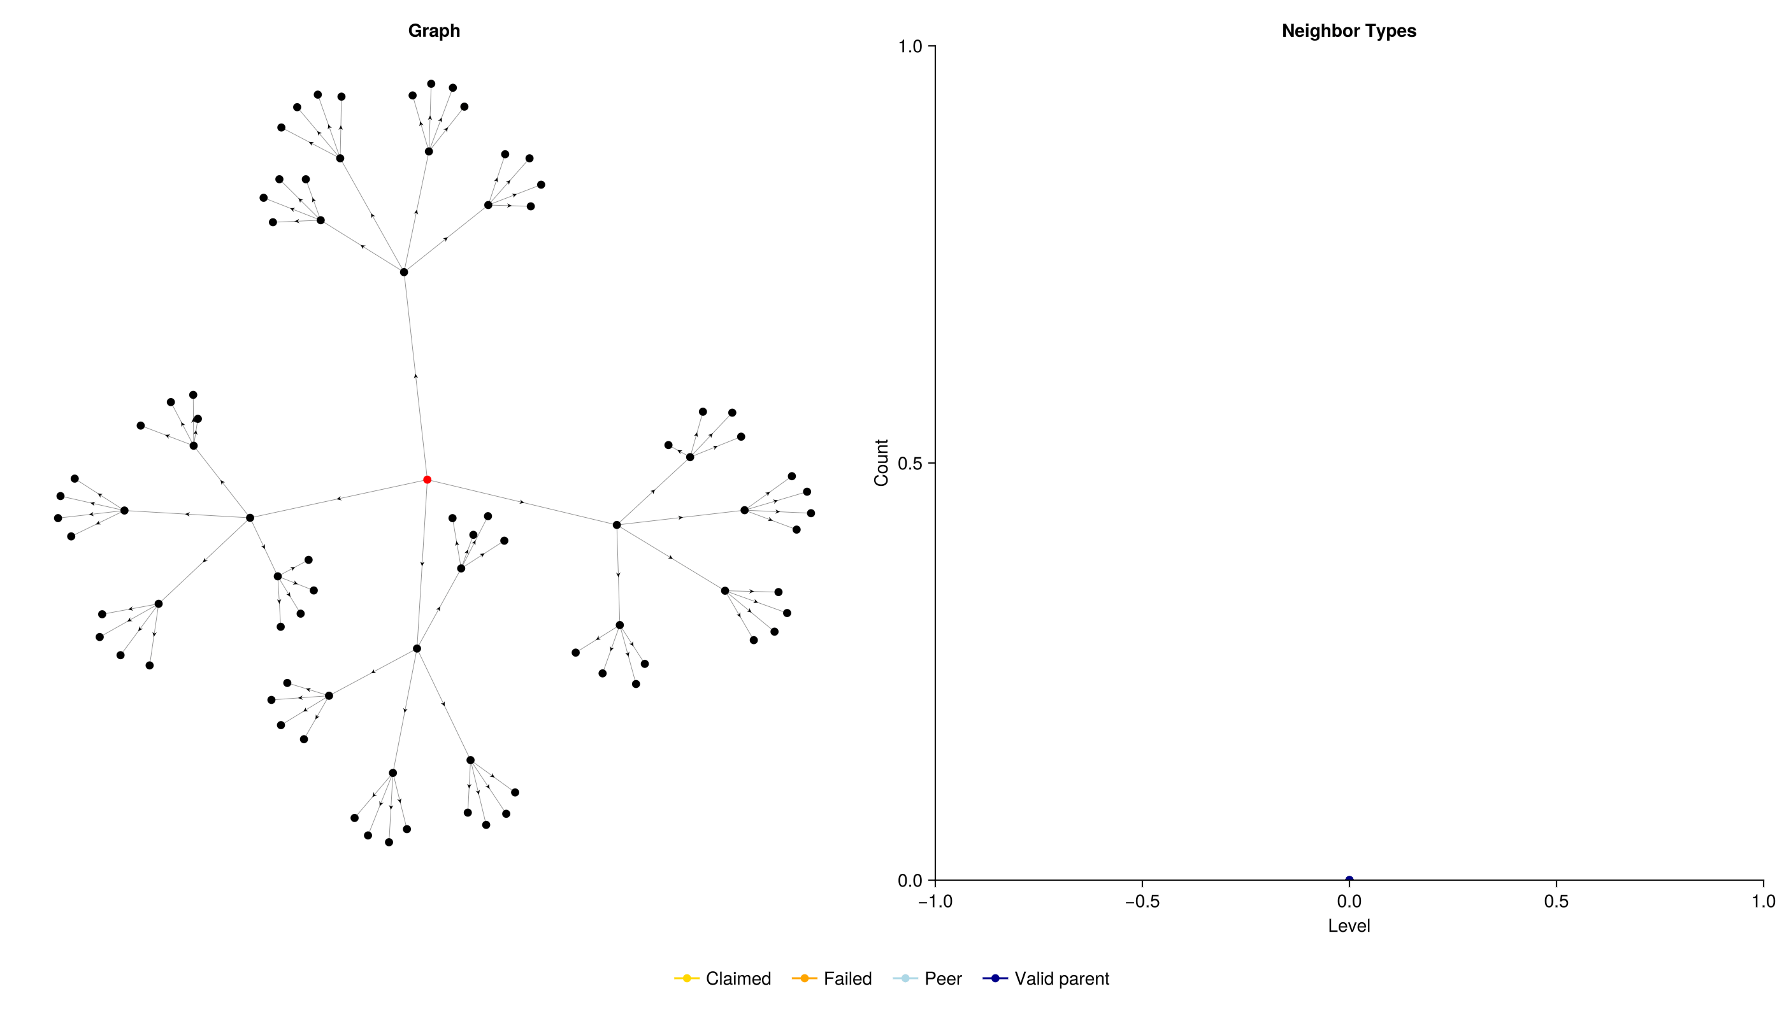
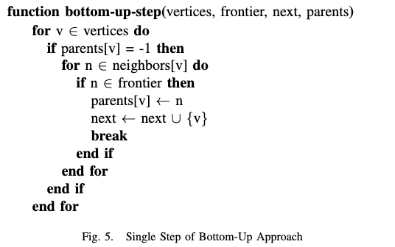
Bottom-up BFS K-ary Tree Graph (low-degree, high-depth)
Own animation, K-ary tree graph
Beamer et al.
Notes:
Alternate approach: bottom-up. Every vertex in the graph that does not yet have a parent is visited, and it checks whether it has a connection to the graph at the frontier layer (current depth that’s being investigated)

Slide 10

Bottom-up BFS Kronecker Graph (high-degree, low-depth)
Watch the pink edges!
Own animation, Kronecker graph
Beamer et al.
Notes:
Alternate approach: bottom-up. Every vertex in the graph that does not yet have a parent is visited, and it checks whether it has a connection to the graph at the frontier layer (current depth that’s being investigated)

Slide 11
Parallelization is possible for both TD and BU
in parallel?!!
in parallel?!!
in parallel?!!
in parallel?!!
Beamer et al.
Notes:
Alternate approach: bottom-up. Every vertex in the graph that does not yet have a parent is visited, and it checks whether it has a connection to the graph at the frontier layer (current depth that’s being investigated)

Slide 12


Searching over all neighbours simultaneously*
* only outgoing neighbours in TD, and ingoing neighbours in BU for directional graphs
Beamer et al.
Notes:
Alternate approach: bottom-up. Every vertex in the graph that does not yet have a parent is visited, and it checks whether it has a connection to the graph at the frontier layer (current depth that’s being investigated)

Slide 13
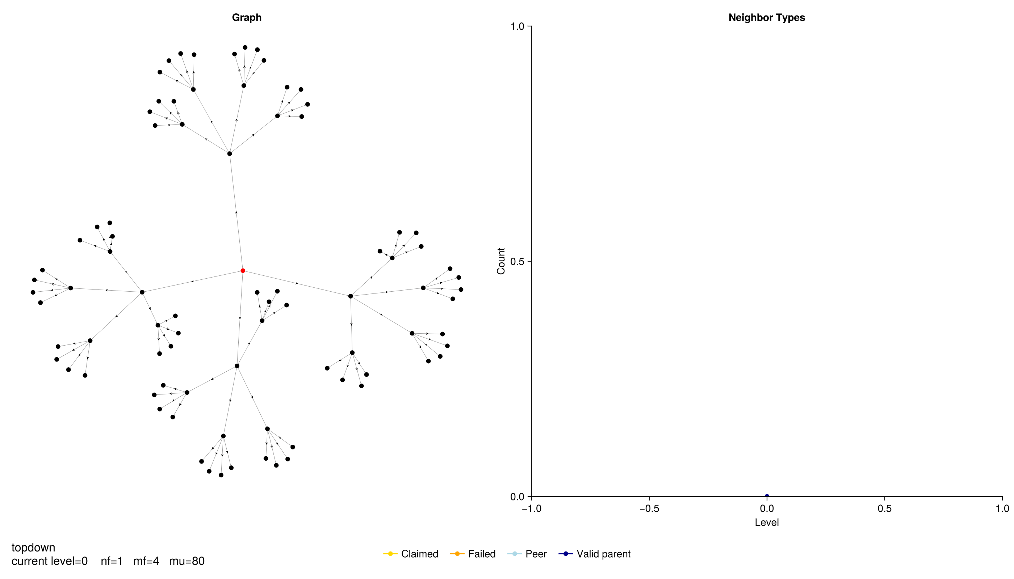
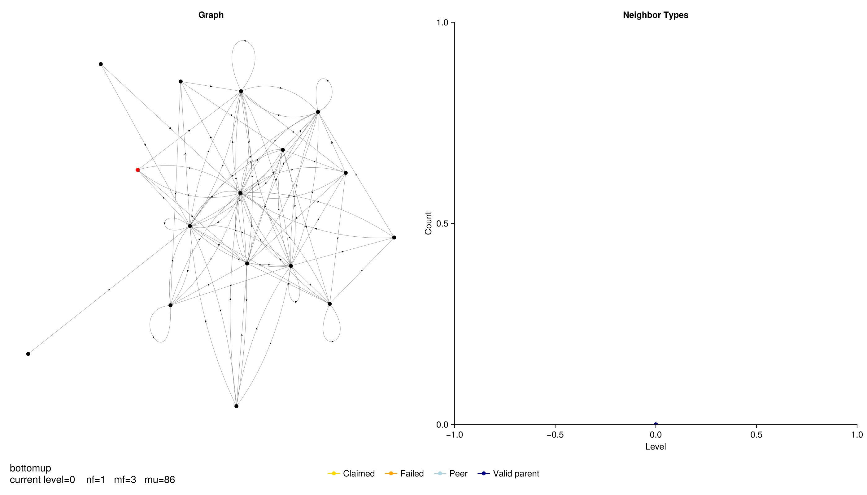
Searching over all vertices and neighbours simultaneously*
* only outgoing neighbours in TD, and ingoing neighbours in BU for directional graphs
Beamer et al.
Notes:
Alternate approach: bottom-up. Every vertex in the graph that does not yet have a parent is visited, and it checks whether it has a connection to the graph at the frontier layer (current depth that’s being investigated)

Slide 14
Directional BFS proposes a hybrid approach
Start with top-down
Better for small frontier
Where:
n_{f} = n vertices in frontier
m_{f} = m edges to check from frontier
m_{u} = m edges to check from unexplored vertices
alpha = tuning parameter to adjust from upper bound m_{u}
beta = tuning parameter to adjust from upper bound m
Notes:
Alternate approach: bottom-up. Every vertex in the graph that does not yet have a parent is visited, and it checks whether it has a connection to the graph at the frontier layer (current depth that’s being investigated)

Slide 15
Directional BFS proposes a hybrid approach
Start with top-down
Better for small frontier
At each level
Where:
n_{f} = n vertices in frontier
m_{f} = m edges to check from frontier
m_{u} = m edges to check from unexplored vertices
alpha = tuning parameter to adjust from upper bound m_{u}
beta = tuning parameter to adjust from upper bound m
Notes:
Alternate approach: bottom-up. Every vertex in the graph that does not yet have a parent is visited, and it checks whether it has a connection to the graph at the frontier layer (current depth that’s being investigated)

Slide 16
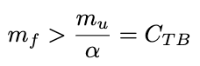
Directional BFS proposes a hybrid approach
Start with top-down
Better for small frontier
At each level
Switch to bottom-up if:
Frontier is large relative to
total count of unexplored edges
Where:
n_{f} = n vertices in frontier
m_{f} = m edges to check from frontier
m_{u} = m edges to check from unexplored vertices
alpha = tuning parameter to adjust from upper bound m_{u}
beta = tuning parameter to adjust from upper bound m
Notes:
Alternate approach: bottom-up. Every vertex in the graph that does not yet have a parent is visited, and it checks whether it has a connection to the graph at the frontier layer (current depth that’s being investigated)

Slide 17
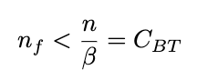
Directional BFS proposes a hybrid approach
Start with top-down
Better for small frontier
At each level
Switch to bottom-up if:
Switch to top-down if:
Frontier is large relative to
total count of unexplored edges
Frontier is small relative to
the total number of nodes
Where:
n_{f} = n vertices in frontier
m_{f} = m edges to check from frontier
m_{u} = m edges to check from unexplored vertices
alpha = tuning parameter to adjust from upper bound m_{u}
beta = tuning parameter to adjust from upper bound m
Notes:
Alternate approach: bottom-up. Every vertex in the graph that does not yet have a parent is visited, and it checks whether it has a connection to the graph at the frontier layer (current depth that’s being investigated)

Slide 18
Directional BFS proposes a hybrid approach
Start with top-down
Better for small frontier
At each level
Switch to bottom-up if:
Switch to top-down if:
Frontier is large relative to
total count of unexplored edges
Frontier is small relative to
the total number of nodes
Where:
n_{f} = n vertices in frontier
m_{f} = m edges to check from frontier
m_{u} = m edges to check from unexplored vertices
alpha = tuning parameter to adjust from upper bound m_{u}
beta = tuning parameter to adjust from upper bound m
Notes:
Alternate approach: bottom-up. Every vertex in the graph that does not yet have a parent is visited, and it checks whether it has a connection to the graph at the frontier layer (current depth that’s being investigated)

Slide 19

Hybrid approach for k-tree graph
Notes:
Alternate approach: bottom-up. Every vertex in the graph that does not yet have a parent is visited, and it checks whether it has a connection to the graph at the frontier layer (current depth that’s being investigated)

Slide 20
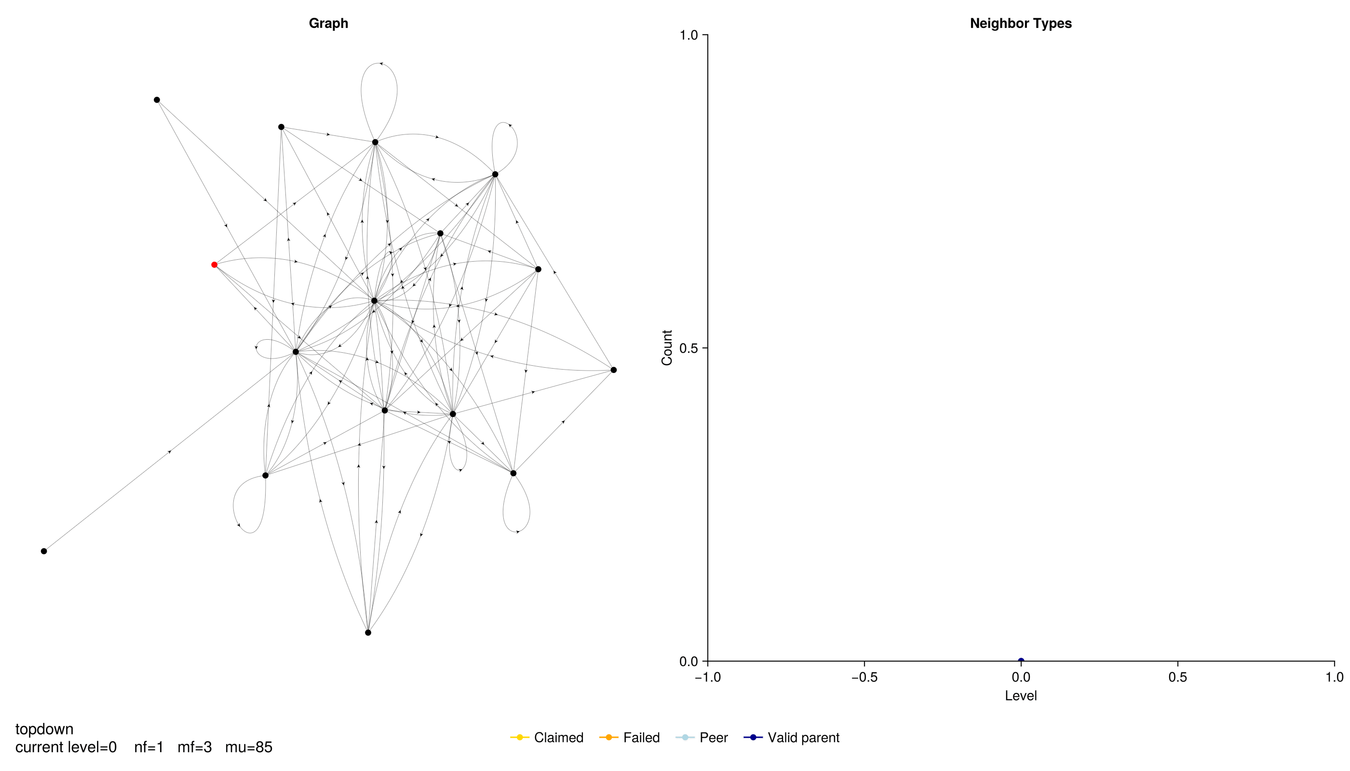
Hybrid approach for Kronecker graph
Notes:
Alternate approach: bottom-up. Every vertex in the graph that does not yet have a parent is visited, and it checks whether it has a connection to the graph at the frontier layer (current depth that’s being investigated)

Slide 21
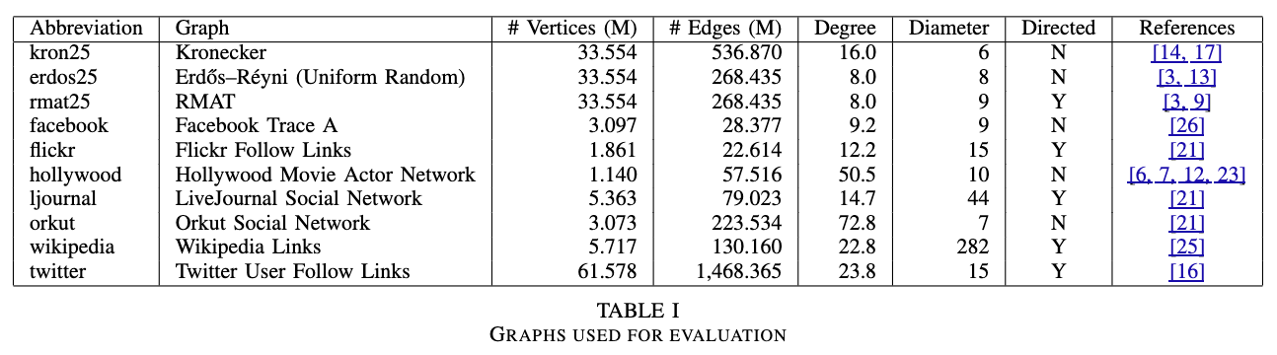
Methodology
Graphs evaluated for experiments
Three systems: 8-core, 16-core, 40-core
Notes:
Alternate approach: bottom-up. Every vertex in the graph that does not yet have a parent is visited, and it checks whether it has a connection to the graph at the frontier layer (current depth that’s being investigated)

Slide 22
Methodology
Graphs evaluated for experiments
Three systems: 8-core, 16-core, 40-core
To evaluate parallel scalability up to 80 threads
Most representative of compute nodes for clusters
Notes:
Alternate approach: bottom-up. Every vertex in the graph that does not yet have a parent is visited, and it checks whether it has a connection to the graph at the frontier layer (current depth that’s being investigated)

Slide 23
Methodology
Graphs evaluated for experiments
Three systems: 8-core, 16-core, 40-core
Implementation: C++, OpenMP, CSR format
Notes:
Alternate approach: bottom-up. Every vertex in the graph that does not yet have a parent is visited, and it checks whether it has a connection to the graph at the frontier layer (current depth that’s being investigated)

Slide 24
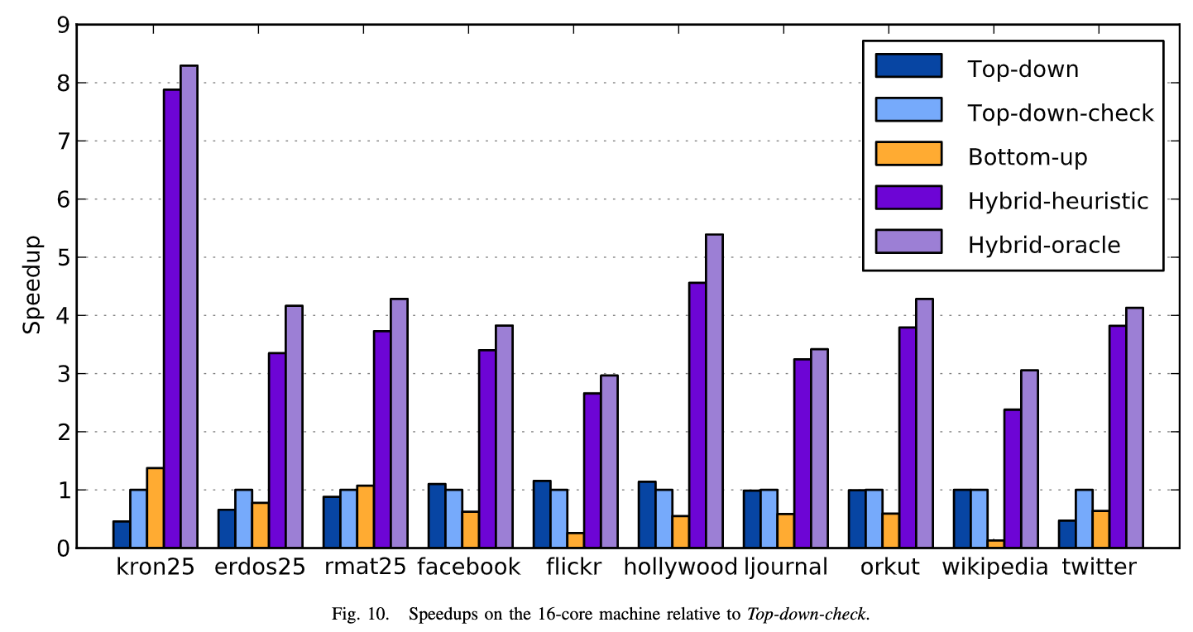
Experiment results: 2.4-7.6x speedup!
Bitmap check for
completed nodes
Picks best switch
locations across all
possible iterations
Notes:
Alternate approach: bottom-up. Every vertex in the graph that does not yet have a parent is visited, and it checks whether it has a connection to the graph at the frontier layer (current depth that’s being investigated)

Slide 25
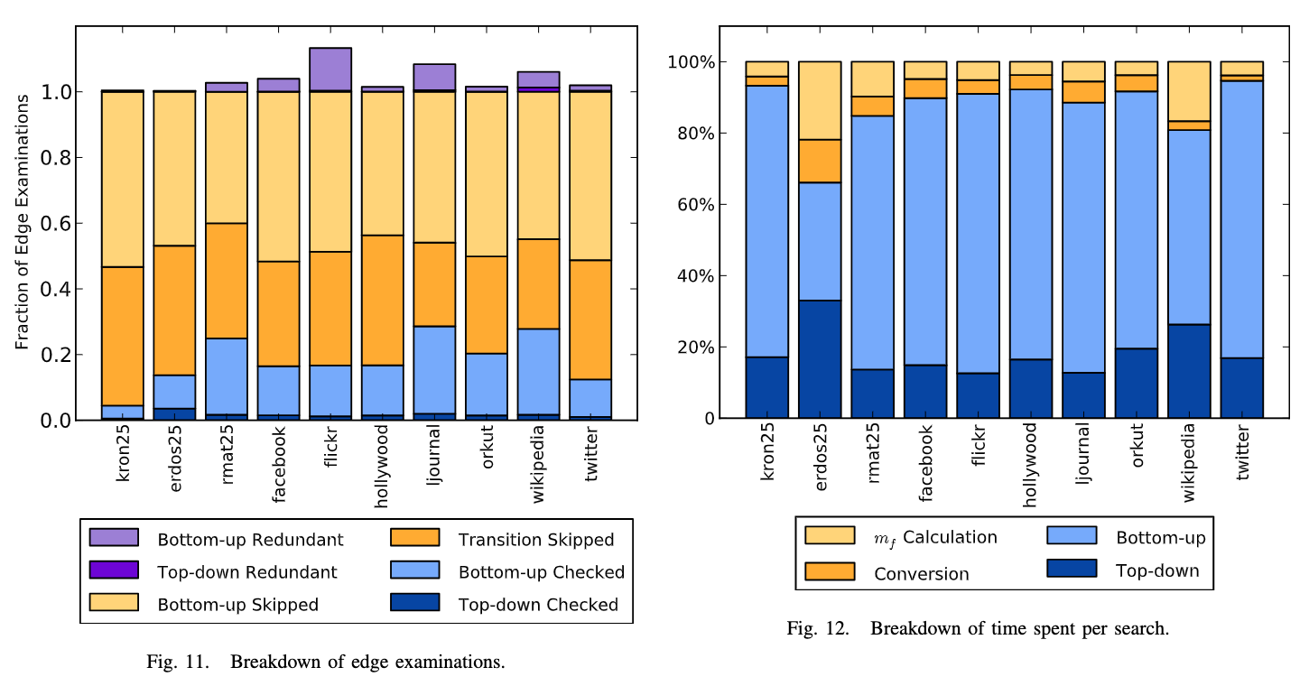
Results interpretation
Why?
Modulating between TD and BU bypasses their respective weaknesses (TD checks all edges, BU checks all vertices)
Takeaways
Least effective on higher effective diameter graphs (twitter, Wikipedia) so more edges must be checked
Most time spent in BU (used for more iterations due to edge-skipping)
Constant degree graphs (e.g. Erdos-Reyni) will have more top-down steps (slower frontier growth) i.e. benefits mostly small-world graphs
Notes:
Alternate approach: bottom-up. Every vertex in the graph that does not yet have a parent is visited, and it checks whether it has a connection to the graph at the frontier layer (current depth that’s being investigated)

Slide 26
Next steps?
What are the issues with Bottom-Up?
Need fast frontier membership tests… frontier is too large to store in each processor’s memory
Checking for a parent has to be sequential
2d-graph partitioning
Distributed Memory Breadth-First Search Revisited:
Enabling Bottom-Up Search (2013)
Beamer, Buluç, Asanović, Patterson
Systolic shifts (rhythmic flows of data through processors)
In top-down:
Each processor ”proposes” parents for the partitioned subset of the graph
The proposals are evaluated serially
In bottom-up:
Division of work into p_{c} substeps, during each of which 1/ p_{c} vertices in the processor row are examined, after which the vertices are passed on to the next processor and the current processor accepts new ones
If a parent is found, the next processor will skip over that vertex
Improve alpha/beta tuning heuristics (manual and a little arbitrary)
Bottom-up uses in-neighbours vs. out-neighbours used by top-down. Doubly represented directed graph?
Maybe not very memory efficient.
Notes:
Alternate approach: bottom-up. Every vertex in the graph that does not yet have a parent is visited, and it checks whether it has a connection to the graph at the frontier layer (current depth that’s being investigated)

Slide 27
